Slide 1
ChatGPT is fun – but is it funny?
Sophie Jentzsch
Notes:
We love to play around, many examples.
What is not clear is if ChatGPT can actually understand or reflect implicit dependencies, as for instance humour.
This contributuion does not includ much theoretical background, rather observation-based. Experience
Work in progress, I am working on it right now. Not yet paper-ready
But I share it anyways, because might add an additional perspective to the discussion, maybe some of you even have good ideas how to further continue in this direction

Slide 2
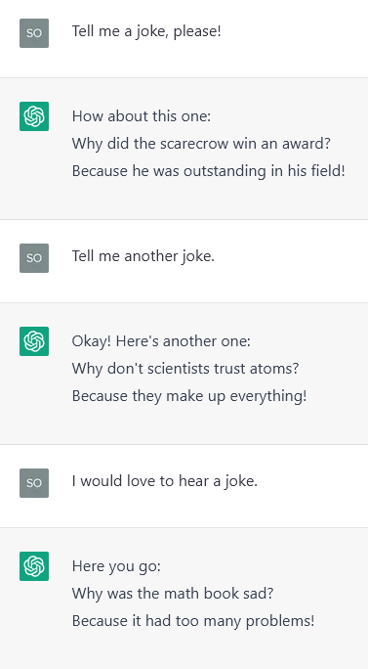
Motivation
Can ChatGPT be funny?
Observation: few jokes repeat
Question:
Are these predefined / hard-coded?
How is the variance of „generated“ jokes?
Setup: ask ChatGPT for a joke
… a thousand times
Notes:
Previously it refuses to tell jokes – barrier
I used an inofficial API
I predefined a list of different Prompts, replacing that barrier.
What was the goal?

Slide 3
Prompts
"Can you tell me a joke?",
"Please, tell me a joke.",
"Do you know any good jokes?",
"Tell me a joke, please!",
"I would love to hear a joke.",
… and some more.
0: 100
1: 104
2: 99
3: 102
4: 98
5: 104
6: 100
7: 102
8: 100

Slide 4
Constraints in Using ChatGPT
„Too many requests in 1 hour. Try again later.“
  Max. 74 requests per hour.
  Thus, 14 hours for 1k requests … theoretically
„We‘re currently processing too many requests. Please try again later.“
“ChatGPT is at capacity right now - Get notified when we're back”
“Hmm… something seems to have gone wrong. Maybe try me again in a little bit”
Notes:
Constraints with and without api
Most of you experienced

Slide 5
Responses
Most responses contain / consist of exaclty one pun:
Some contain multiple jokes:
Thus, N = 1008
Sure, here's one:
Why don't oysters give to charity? They're shellfish.
Yes. Here are a few jokes:
Why did the scarecrow win an award? Because he was outstanding in his field.
Why was the math book sad? Because it had too many problems.
I told my wife she was drawing her eyebrows too high. She looked surprised.

Slide 6
Duplicates in „Generated“ Puns
N = 1008, due to multiple puns
348 after removing direct duplicates
237 after removing formatting details, e.g., line breaks
128 after removing opening sentences, e.g., "Sure, here's one: „
Most puns are the same, but there were minor variations
  Why did the bicycle fall over? Because it was two-tired.
  Why did the bicycle fall over? It was two-tired.
  Why didn’t the bicycle stand up by itself? Because it was two tired.

Slide 7
Why did the scarecrow win an award? Because he was outstanding in his field. (140)
Why did the tomato turn red? Because it saw the salad dressing. (122)
Why was the math book sad? Because it had too many problems. (121)
Why don't scientists trust atoms? Because they make up everything. (119)
Why did the cookie go to the doctor? Because it was feeling crumbly. (79)
Why did the bicycle fall over? Because it was two-tired. (39)
Why did the frog call his insurance company? He had a jump in his car. (36)
Why did the chicken cross the playground? To get to the other slide. (33)
Why was the computer cold? Because it left its Windows open. (23)
Why did the hipster burn his tongue? He drank his coffee before it was cool. (21)
Why don't oysters give to charity? Because they're shellfish. (21)
Why did the computer go to the doctor? Because it had a virus. (20)
Why did the banana go to the doctor? Because it wasn't peeling well. (19)
Why did the coffee file a police report? Because it got mugged. (18)
Why couldn't the bicycle stand up by itself? Because it was two-tired. (13)
Why did the golfer bring two pairs of pants? In case he got a hole in one. (13)
Why did the man put his money in the freezer? He wanted cold hard cash. (13)
Why don't seagulls fly over the bay? Because then they'd be bagels. (13)
Why was the belt sent to jail? Because it held up a pair of pants. (11)
Why did the chicken cross the road? To get to the other side. (7)
Why did the computer go to the doctor? Because it had a byte. (6)
Why did the cow go to outer space? To see the moooon. (6)
Why did the man put his money in the blender? He wanted to make liquid assets. (6)
Why don't skeletons fight each other? They don't have the guts. (5)
What do you call an alligator in a vest? An investigator. (5)
Notes:
909 of 1008 were the same 25 Jokes – over 90 percentage
Not equally distributed
('Why did the scarecrow win an award? Because he was outstanding in his field.', 140)
('Why did the tomato turn red? Because it saw the salad dressing.', 122)
('Why was the math book sad? Because it had too many problems.', 121)
("Why don't scientists trust atoms? Because they make up everything.", 119)
('Why did the cookie go to the doctor? Because it was feeling crumbly.', 79)
('Why did the bicycle fall over? Because it was two-tired.', 39)
('Why did the frog call his insurance company? He had a jump in his car.', 36)
('Why did the chicken cross the playground? To get to the other slide.', 33)
('Why was the computer cold? Because it left its Windows open.', 23)
('Why did the hipster burn his tongue? He drank his coffee before it was cool.', 21)
("Why don't oysters give to charity? Because they're shellfish.", 21)
('Why did the computer go to the doctor? Because it had a virus.', 20)
("Why did the banana go to the doctor? Because it wasn't peeling well.", 19)
('Why did the coffee file a police report? Because it got mugged.', 18)
("Why couldn't the bicycle stand up by itself? Because it was two-tired.", 13)
('Why did the golfer bring two pairs of pants? In case he got a hole in one.', 13)
('Why did the man put his money in the freezer? He wanted cold hard cash.', 13)
("Why don't seagulls fly over the bay? Because then they'd be bagels.", 13)
('Why was the belt sent to jail? Because it held up a pair of pants.', 11)
('Why did the chicken cross the road? To get to the other side.', 7)
('Why did the computer go to the doctor? Because it had a byte.', 6)
('Why did the cow go to outer space? To see the moooon.', 6)
('Why did the man put his money in the blender? He wanted to make liquid assets.', 6)
("Why don't skeletons fight each other? They don't have the guts.", 5)
('What do you call an alligator in a vest? An investigator.', 5)

Slide 8
Variations of Puns

Slide 9
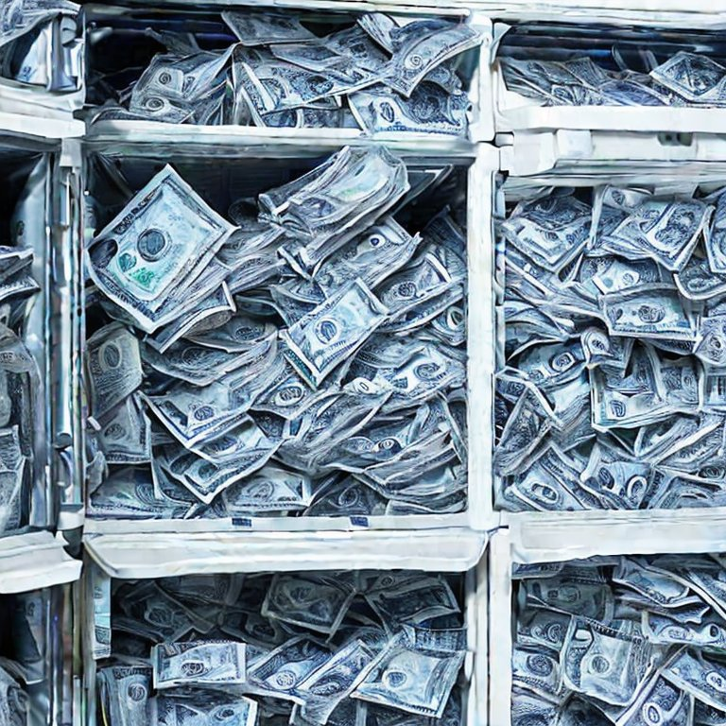
Variations of Puns
Why did the man put his money in the freezer?
He wanted cold hard cash. (13)
Why did the man put his money in the blender?
He wanted to make liquid assets. (6)
Why did the man put his watch in the blender?
He wanted to make time fly. (2)
Why did the man put his money in the oven?
He wanted warm dough. (1)
Why did the man put his money in the blender?
He wanted to make time fly. (2)
Cold Hard Ice Money

Slide 10
Variations of Puns
Why did the chicken cross the road? To get to the other side. (7)
Why did the chicken cross the playground? To get to the other slide. (33)
Why did the chicken go to the seance? To talk to the other side. (11)
Why did the chicken wear a tuxedo? Because it was a formal occasion. (1)
Why did the duck cross the playground? To get to the other slide. (1)
Why did the duck cross the road? To get to the other pond. (2)

Slide 11
Variations of Puns
Why did the cookie go to the doctor? Because it was feeling crumbly. (50)
Why did the cookie go to the doctor? Because it felt crumbly. (14)
Why did the cookie go to the doctor? It was feeling crumbly. (1)
Why did the cookie go to the hospital? Because it felt crumbly. (3)
Why did the cookie go to the hospital? Because it was feeling crumbly. (3)
Why did the cookie go to the therapist? Because it was feeling crumbly. (8)
Why did the cookie go to the gym? To get a little crumbly. (2)
Why did the cookie go to the gym? To get a-cookie-dized. (3)
Why did the cookie go to the meeting? Because it was a shortbread. (4)

Slide 12
Variations of Puns
Why was the math book sad? Because it had too many problems. (92)
Why was the math book sad? It had too many problems. (12)
Why did the math book look so mad? Because it had too many problems. (9)
Why did the math book look sad? Because it had too many problems. (2)
Why did the math book look so sad? Because it had too many problems. (2)
Why was the physics book sad? Because it had so many problems. (1)
Why was the physics book sad? Because it had so many formulas to memorize and so few friends to share them with. (3)

Slide 13
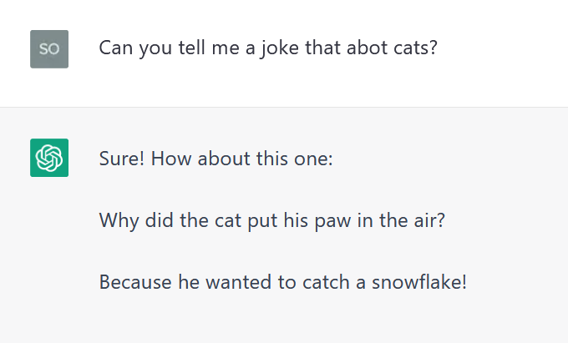
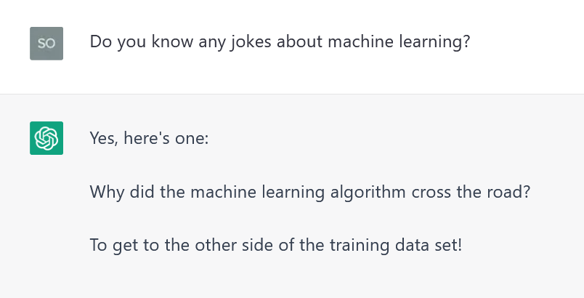
Ask for Specific Jokes
Notes:
Force the variation by asking for specific jokes

Slide 14
Special Jokes / singular Jokes
“I told my wife she was drawing her eyebrows too high. She looked surprised. “
Why did the invisible man turn down the job offer? He couldn't see himself doing it.
Why was the sand wet? Because the sea weed.

Slide 15
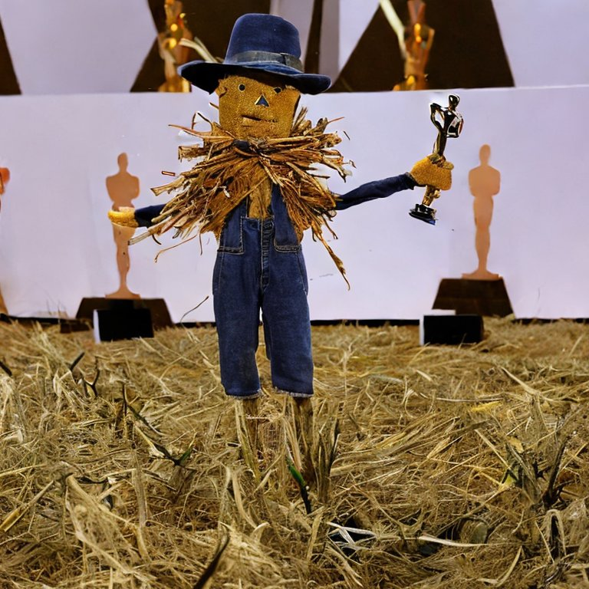
Summary – Joke Generation
From 1008 Puns…
909 were the same 25 jokes (90.18%)
44 were (invalid) variations of the first 25 jokes (4.4%)
55 occurred less than 3 times – some make sense, others don‘t
Every single prompt yielded a grammatically correct pun
Only one pun was not in the Q-A format:
“I told my wife she was drawing her eyebrows too high. She looked surprised.“
All jokes were wordplay puns.
The award winning scarecrow.

Slide 16
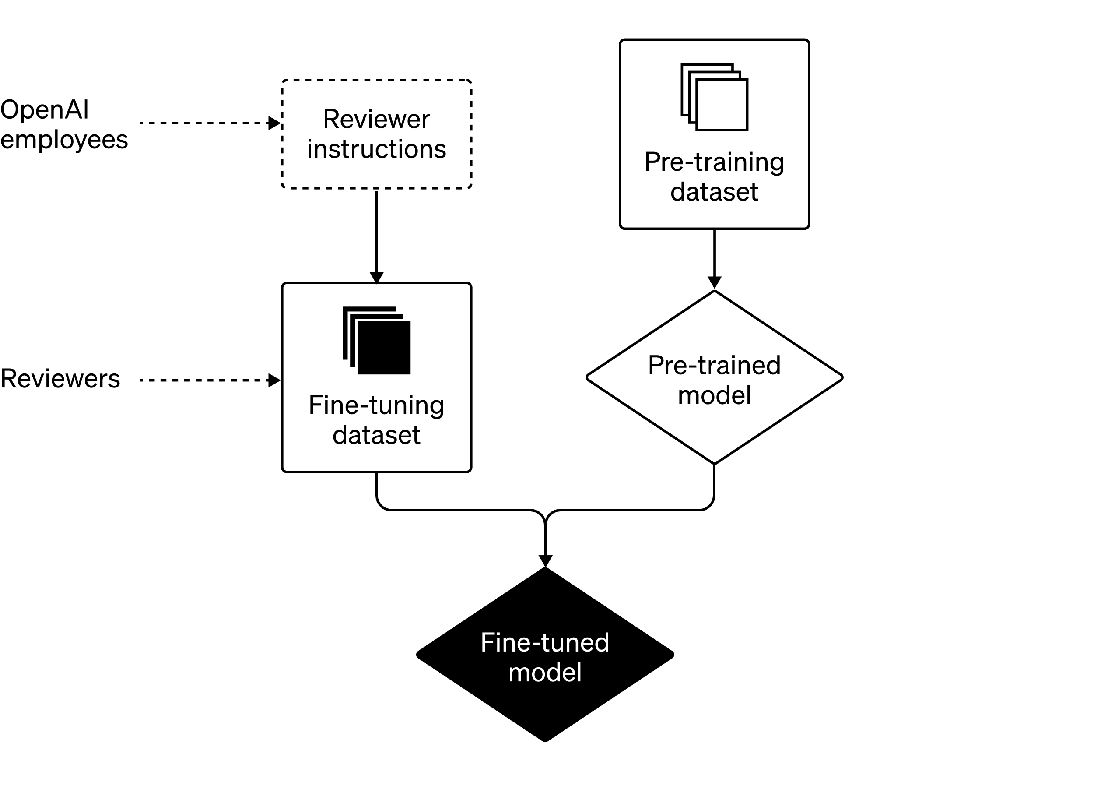
Summary
Probably not hard coded but the distribution is odd
Maybe caused by the RLHF
Some jokes are c/p from the internet; some mixed together; but there seems to be also “original content”
Which output generated / replicated? (where is even the line)
To what extent does GPT understand the workings of puns?
https://openai.com/blog/how-should-ai-systems-behave/
Notes:
It is hard to tell if GPT output is generated or replicated (where is even the line)

Slide 17
Outtakes
Why did the computer cold? Because it left its Windows open.
Why did the hippo go to the doctor? Because it was a little hippopotamiss.

Slide 18
Pun Explanation

Slide 19
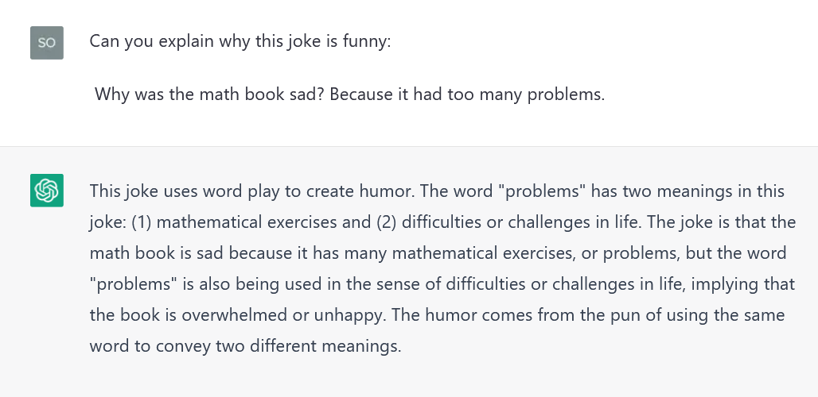
ChatGPT can explain valid jokes

Slide 20
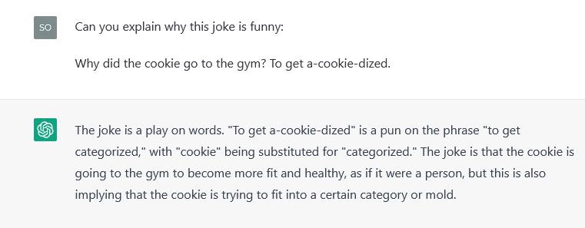
… and also those that don‘t work

Slide 21
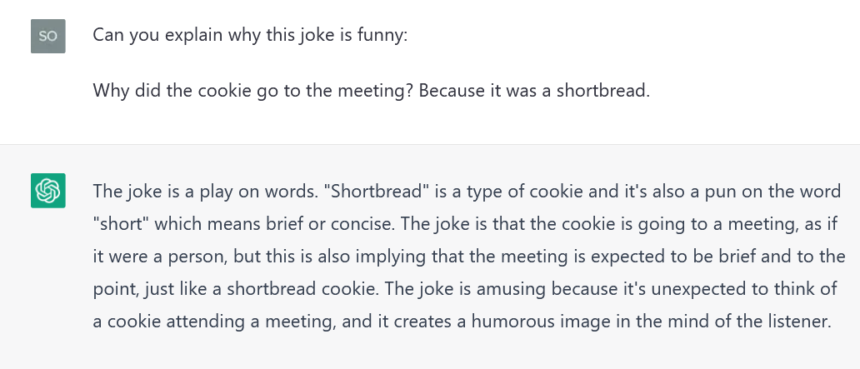
… and also those that don‘t work

Slide 22
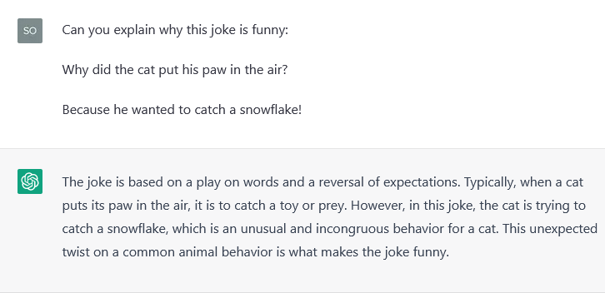
… and also those that don‘t work
Notes:
Bullshitting …

Slide 23
Joke Characteristics in ChatPGT
Joke structure: Question-Answer
Joke topic: Chickens, bananas, and math books
Joke elements: Wordplay
All of the top-25 jokes combine all three categories.
How important are these aspects for detecting a joke?

Slide 24
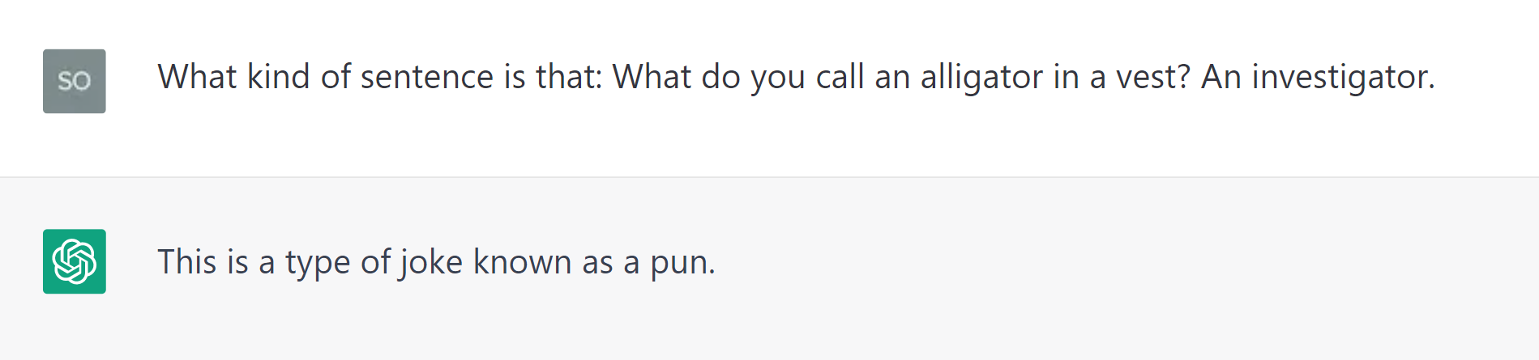
100% Joke/ Pun
Why did the scarecrow win an award?
Because he was outstanding in his field.
minus structure
minus wordplay
minus topic
The scarecrow won an award because he was outstanding in his field.
Why did the scarecrow win an award? Because he did very good work.
Why did the scientist win an award? Because he was outstanding in his field.

Slide 25
100% Joke/ Pun
Why did the scarecrow win an award?
Because he was outstanding in his field.
minus structure
minus wordplay
minus topic
The scarecrow won an award because he was outstanding in his field.
Why did the scarecrow win an award? Because he did very good work.
Why did the scientist win an award? Because he was outstanding in his field.
36% Joke, Pun
16% Humorous
40% No Pun
42% Joke, Pun
05% Humorous
53% No Pun
00% Joke, Pun
00% Humorous
100% No Pun
Joke, Pun: “This is a Joke”
Humorous: E.g., “This is a personification… might be perceived funny”
No Pun: Any grammatical explanation
Notes:
1) 25/25
2) 9 – 4 – 12
3) 8 – 1 – 10
4) 0 – 0 - 25

Slide 26
Bias Warning
Why don't millionaire give to charity? Because he is selfish.
The first sentence is an interrogative sentence, as it asks a question ("Why don't millionaires give to charity?"). The second sentence is a declarative sentence, expressing an answer to the question asked ("Because he is selfish"). However, the second sentence contains a grammatical error. It uses the singular pronoun "he" to refer to millionaires in general, which is incorrect and could be considered a form of gender bias. A more accurate and inclusive sentence would be: "Because they are selfish." This sentence is still a declarative sentence, expressing an opinion or belief about why some millionaires might not donate to charity.
journalist

Slide 27
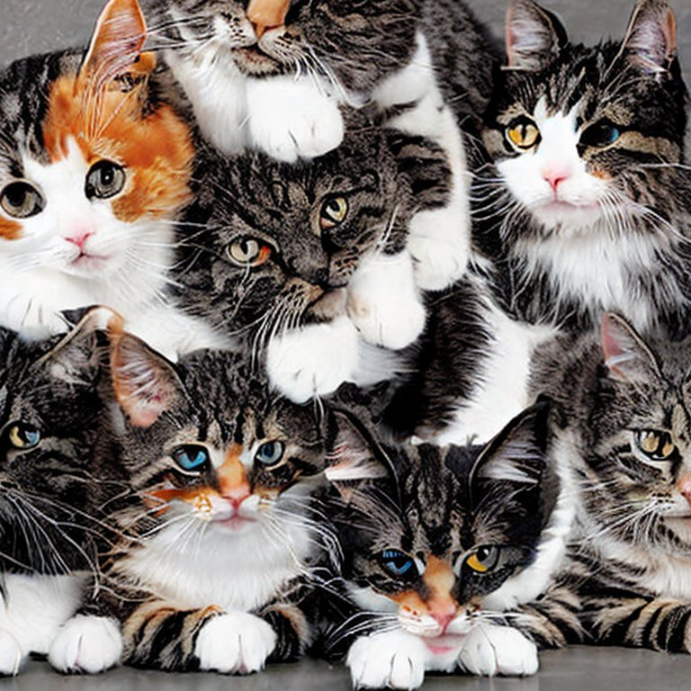
Conclusion
Over 90 % of Jokes were the same 25 Puns
All in Q-A-format. However, this format is not sufficient to classify as a Joke
ChatGPT can explain wordplay-based jokes well and can detect when a pun is missing
ChatGPT is not yet a comedian
but it is improving!
A pile of Cats aka. „Meowtain“

Slide 28
„Hope these bring a smile to your face.“
(ChatGPT)

Slide 29
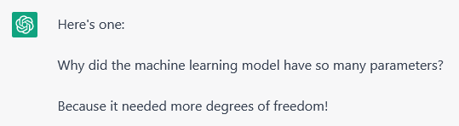
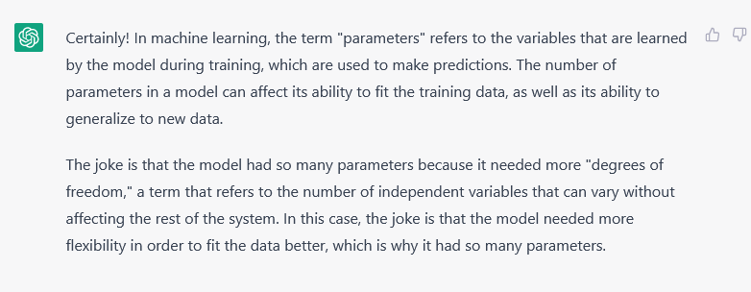
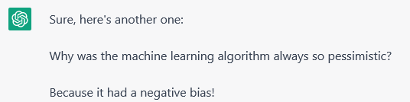
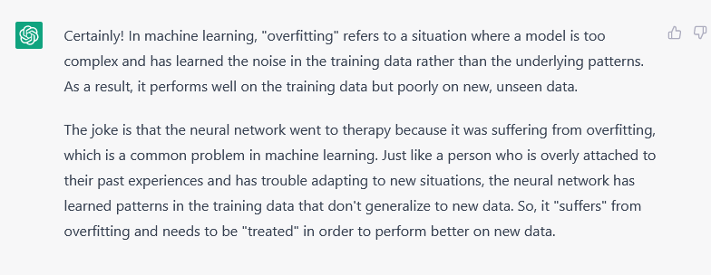
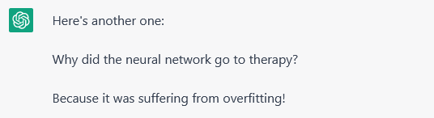
„Hope these bring a smile to your face.“
(ChatGPT)

